Slide 1
Philips Hue light control
Omar Madjitov

Slide 2
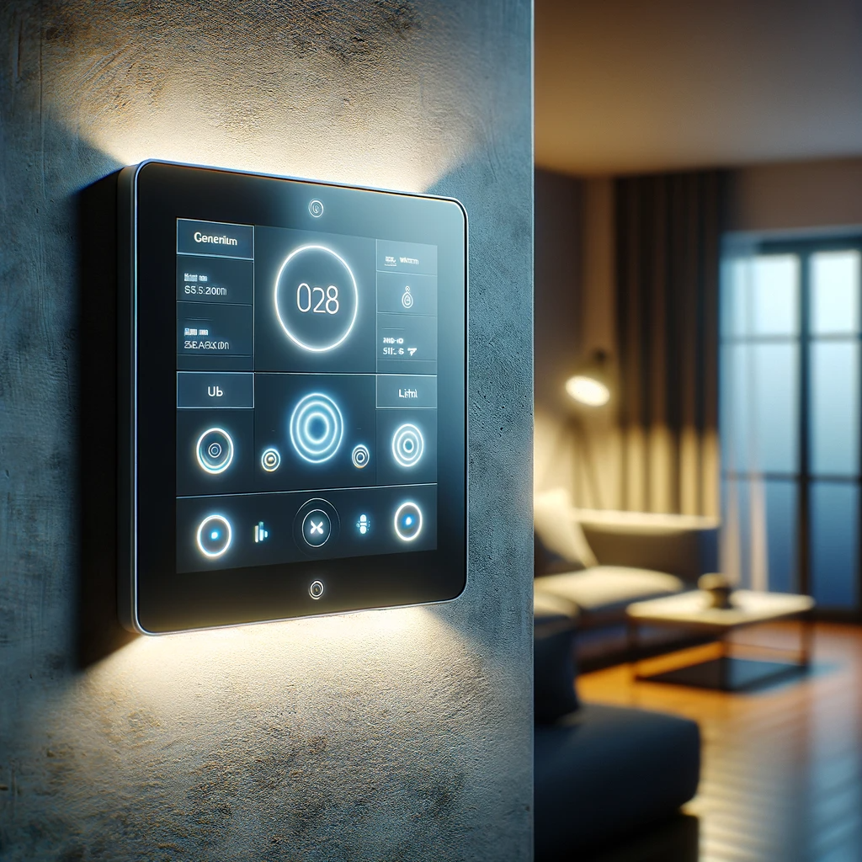
Agenda
INTRODUCTION & MOTIVATION
ABSTRACT
IMPLIMENTATION & CHALLENGES

Slide 3

INTRODUCTION & MOTIVATION
Light is the most important external factor affecting sleep. Light plays a central role in regulating circadian rhythm, the body’s internal clock that signals when to be alert and when to rest. Light also affects the production of melatonin, an essential sleep-promoting hormone.
Daily light exposure, including the type of light we see as well as when and how long we’re exposed to it, has a critical effect on sleep.
Most Importantly when the light hits the outside of our eyelids while we sleep. Our Brains think that it’s a sunrise and starts off the process of “Waking Up”

Slide 4
Abstract look

Slide 5
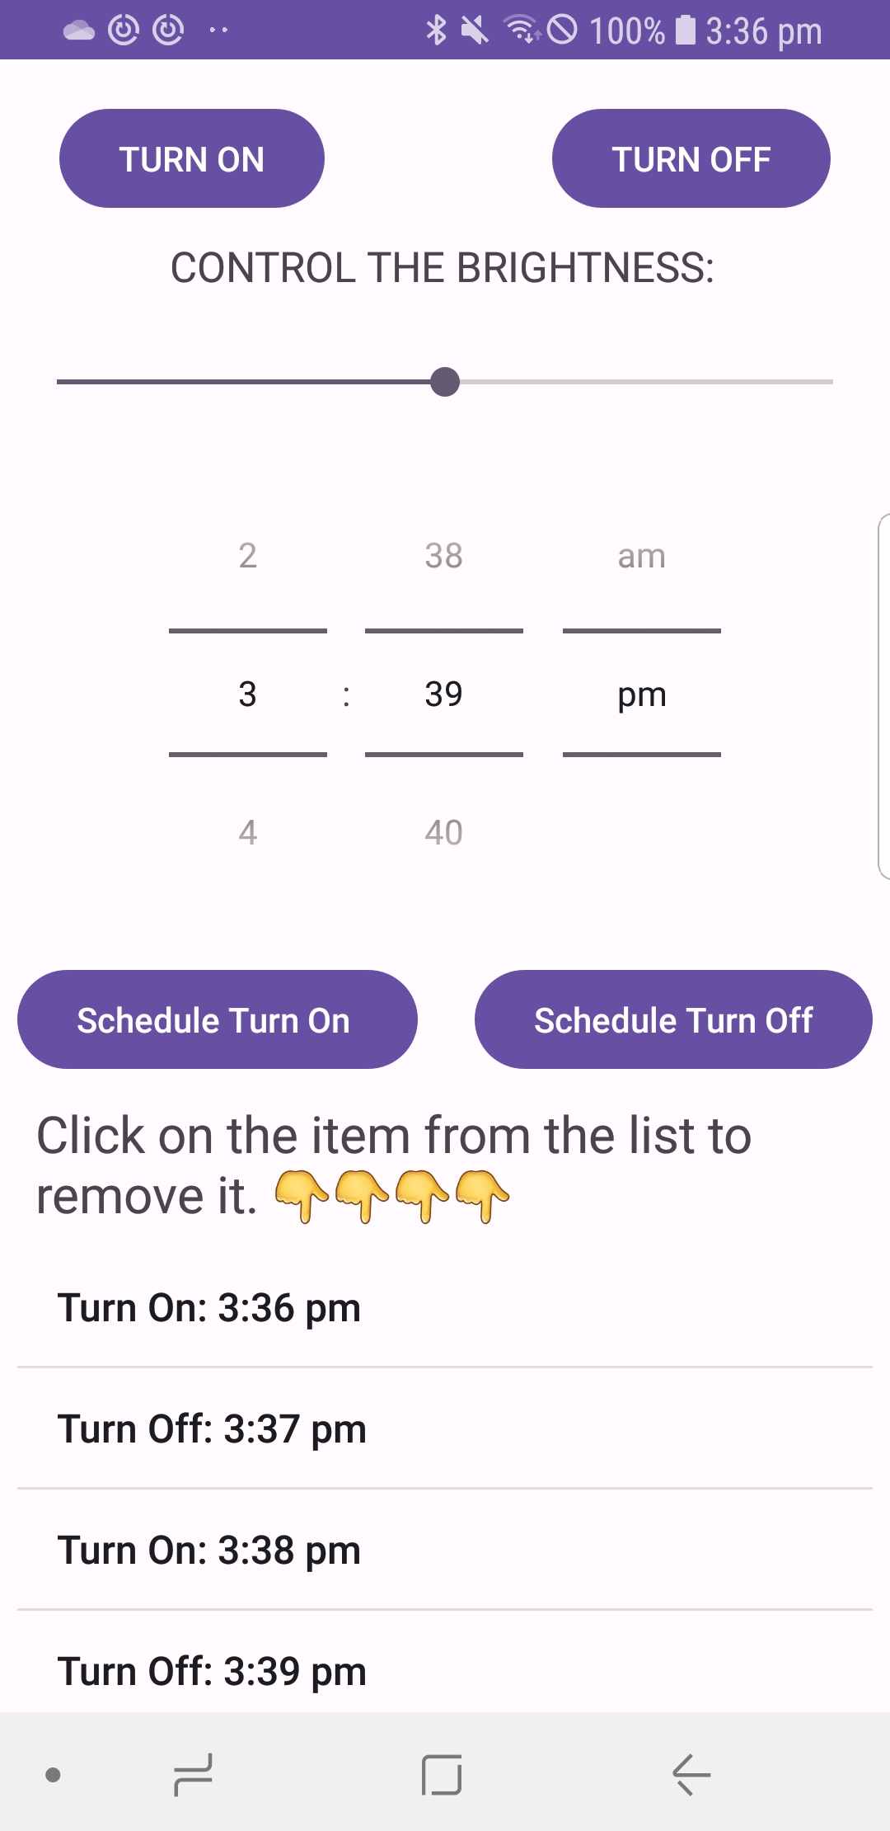
ABSTRACT
Functionality:
Ability to control the light in the real time
Control the Brightness of the light
Ability to Schedule and Remove
Target Audience:
People With thick Curtains who have Hard Time waking up in time
People who don’t have nightstand next to their bed.

Slide 6

Implementation -- initial PLAN
BUILD AN INTERFACE
↓↓↓↓↓↓↓↓
CONNECT BUTTTONS TO A FUNCTIONALITY
↓↓↓↓↓↓↓
GOOD TO GO

Slide 7
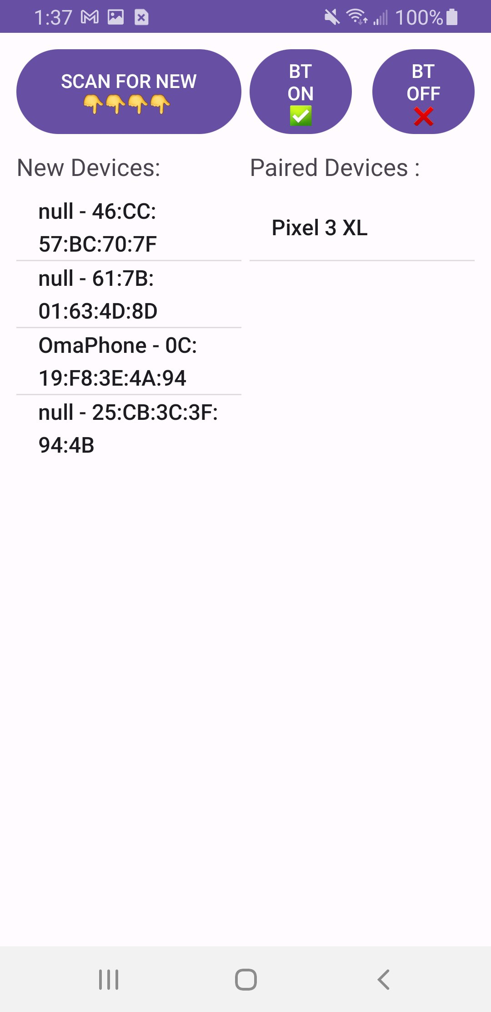
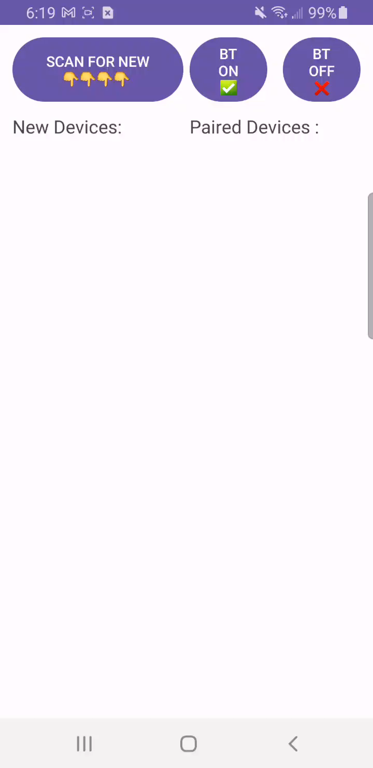
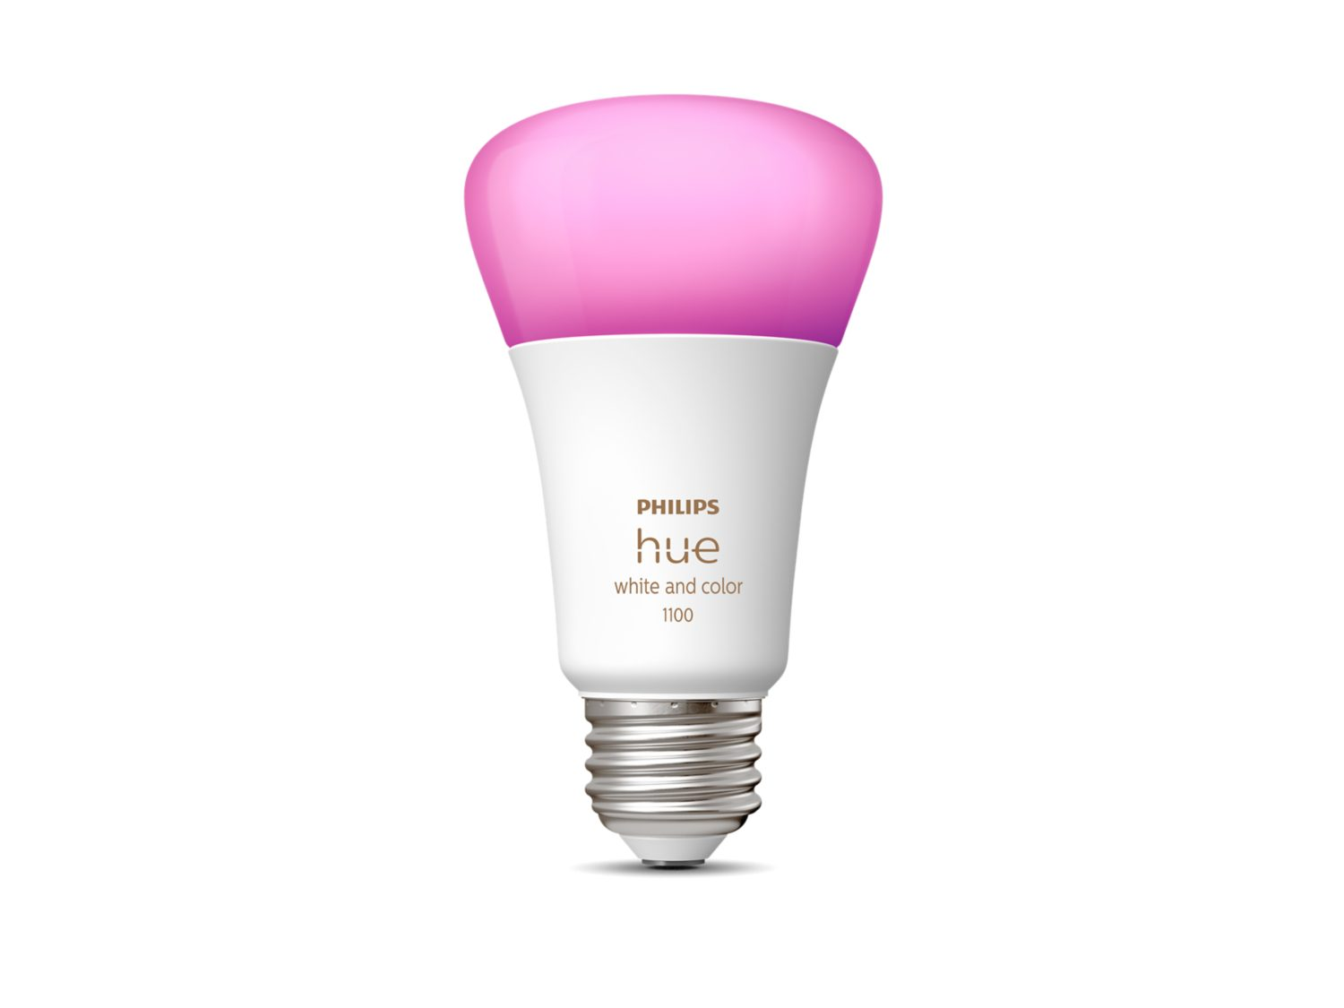
CHALLENGES:
CHALLENGE 1:
Phillips Hue Light Cannot be controlled using APIs Directly, rather it works in a combination with a Hue Bridge.
SOLUTION:
Try to Control the light over the Bluetooth

Slide 8
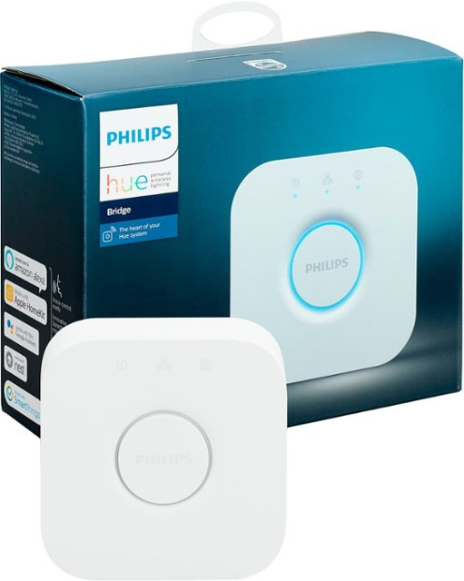
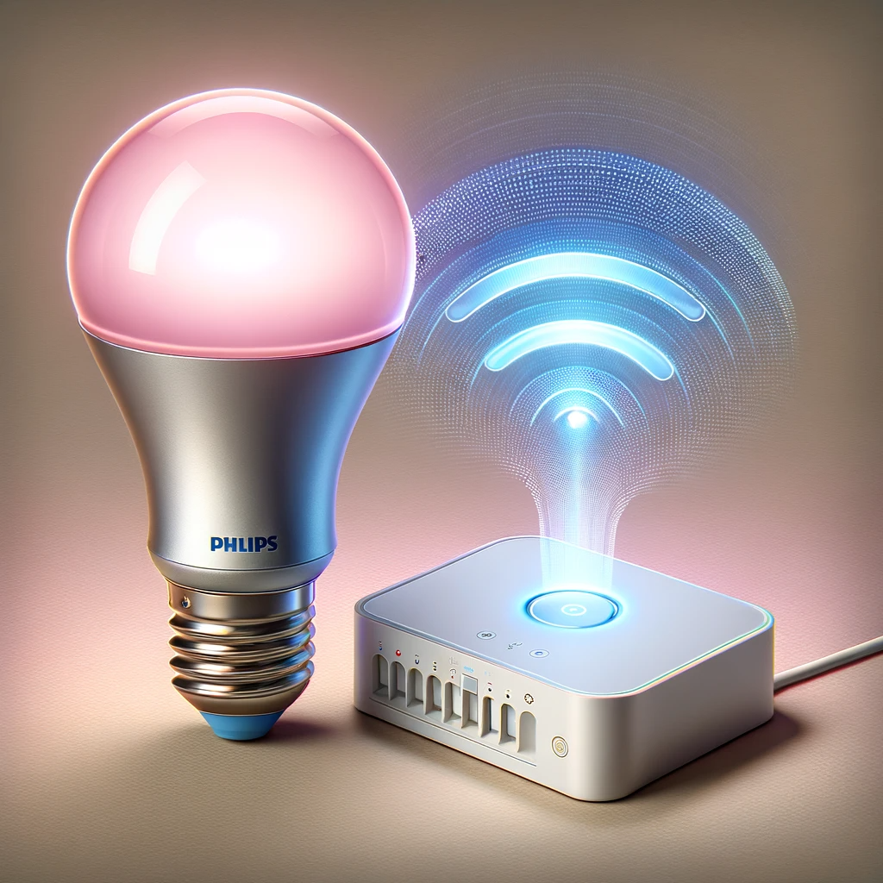
CHALLENGES:
CHALLENGE 2:
There’s very limited documentation on Controlling the Light Over the Bluetooth.
SOLUTION:
Obtain a Hue Bridge -- >
Acquire APIs -->
Re-Design the App

Slide 9
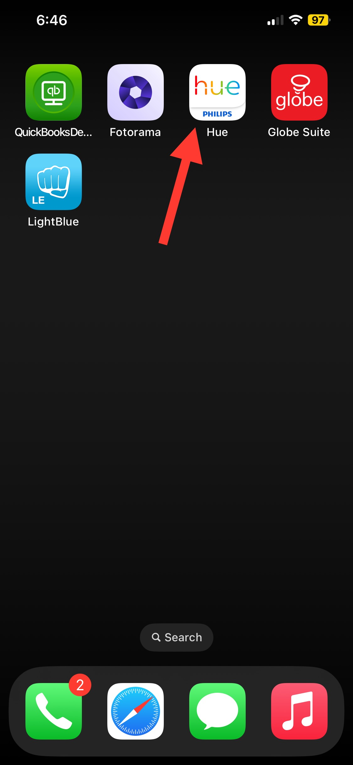
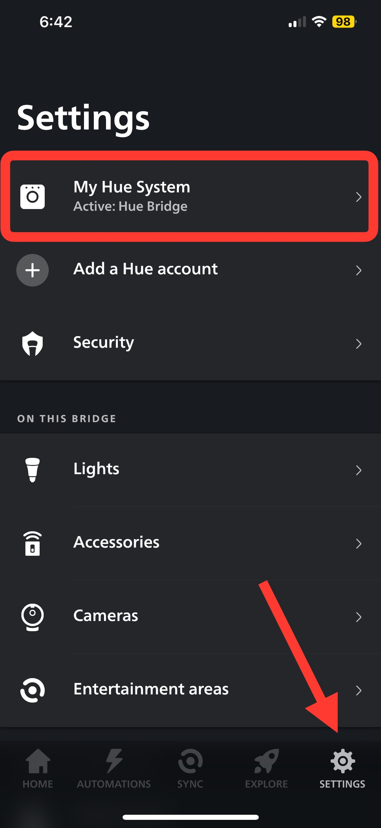
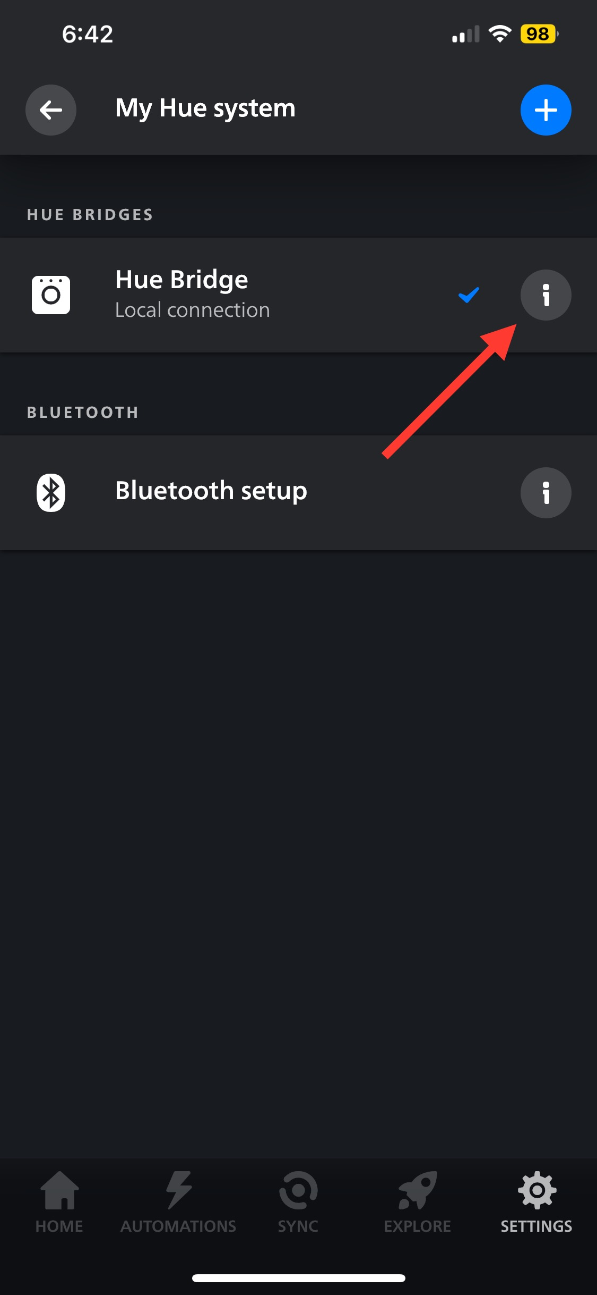
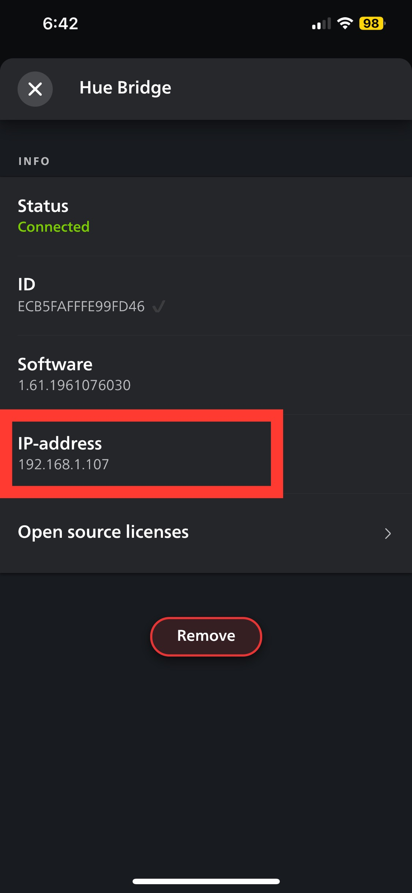
IMPLIMENTATION – redesigned – getting started
1) obtain bridge ip
INSTALL OFFICIAL HUE APP
CLICK
SAVE THE IP OF A BRIDGE
CONNECT TO YOUR HUE BRIDGE

Slide 10
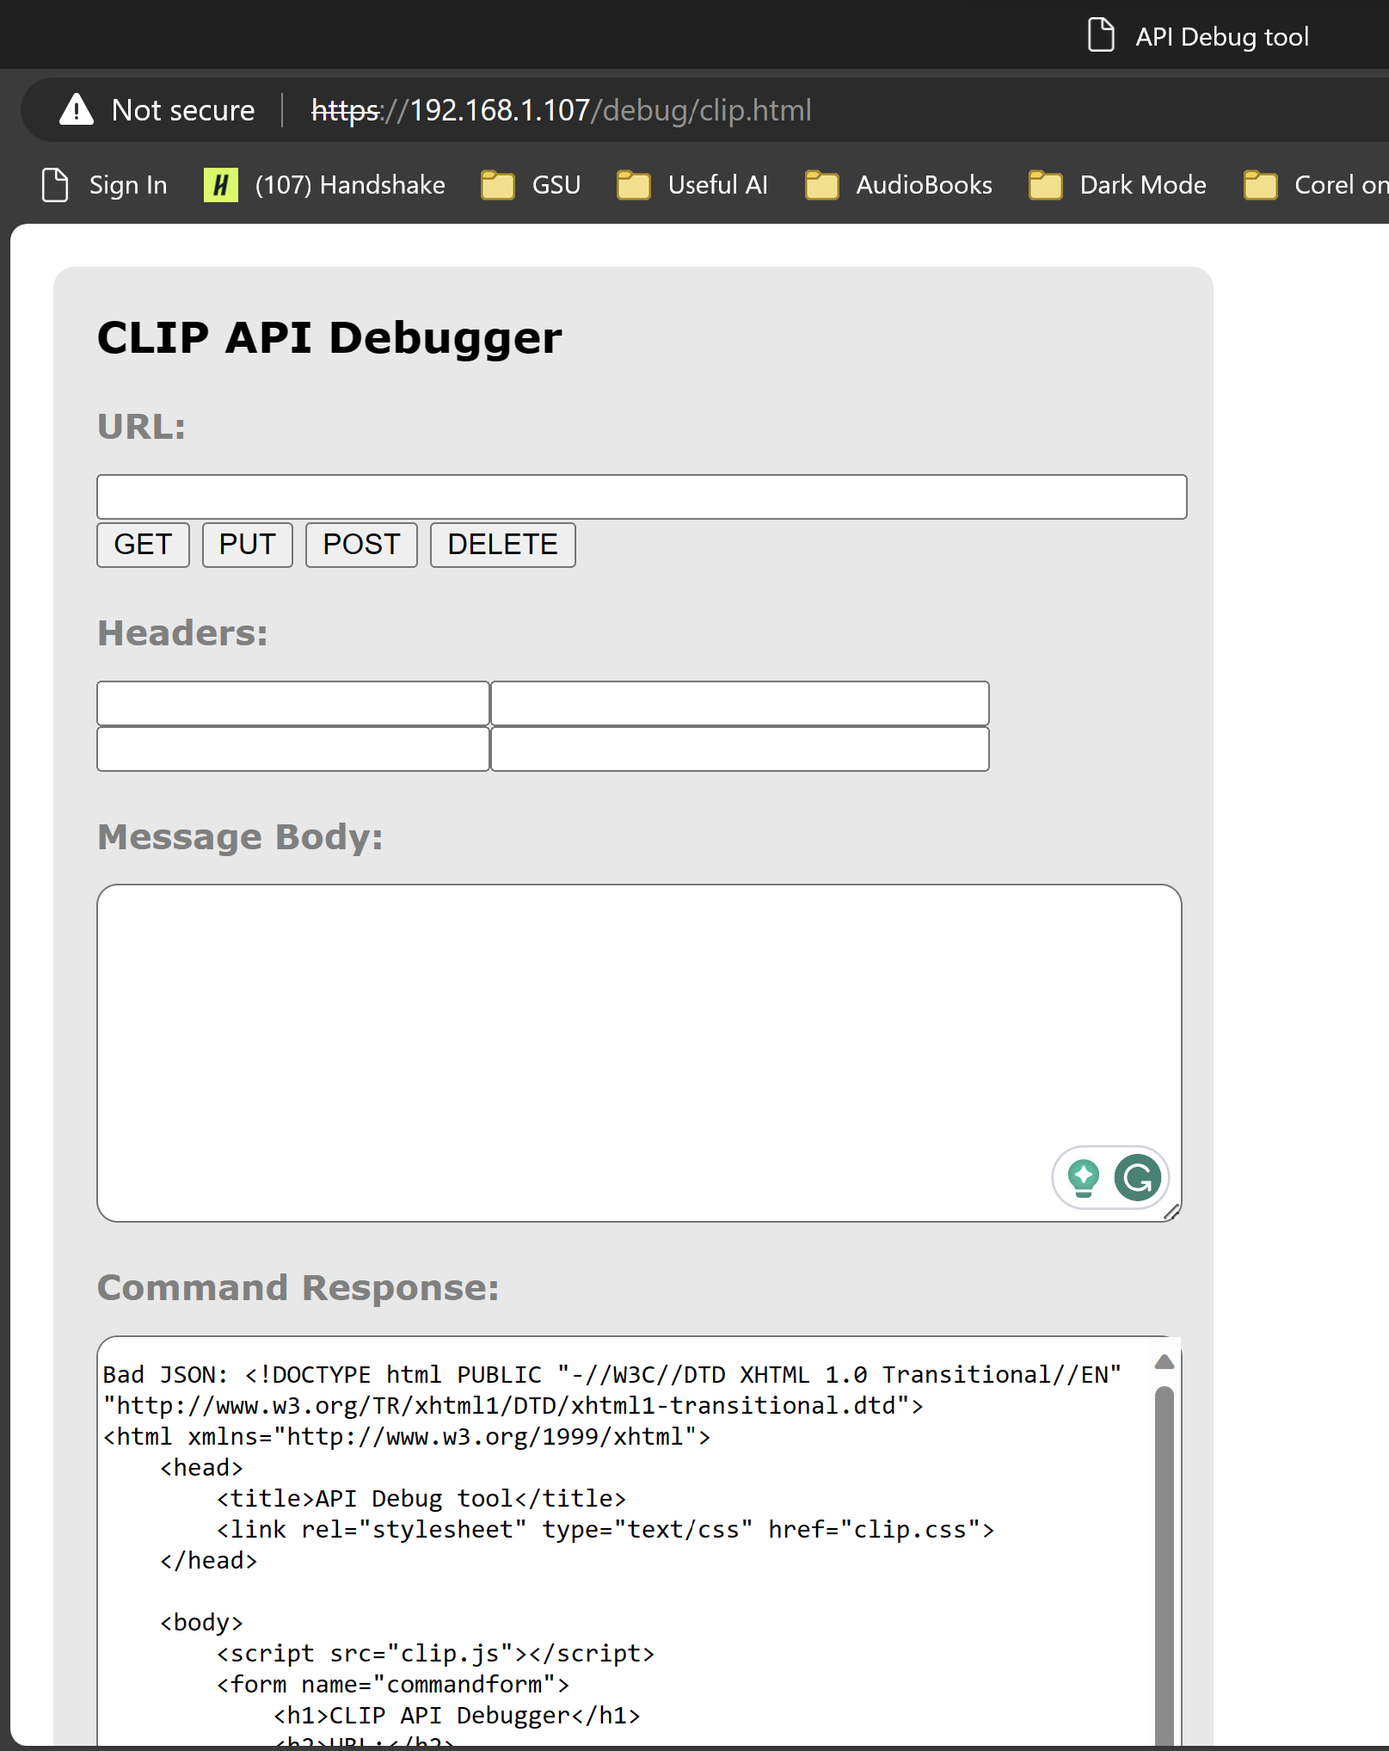
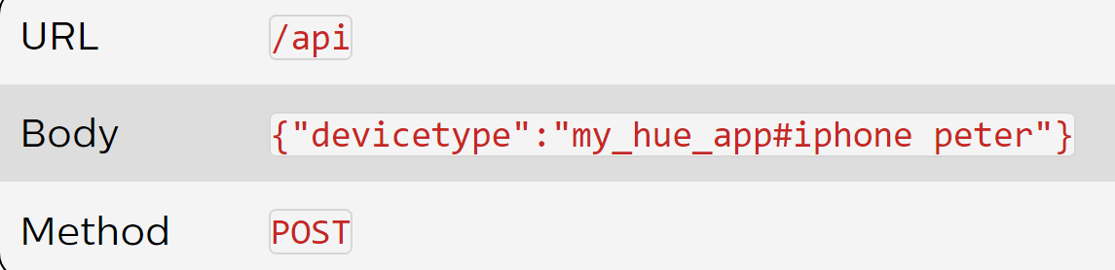
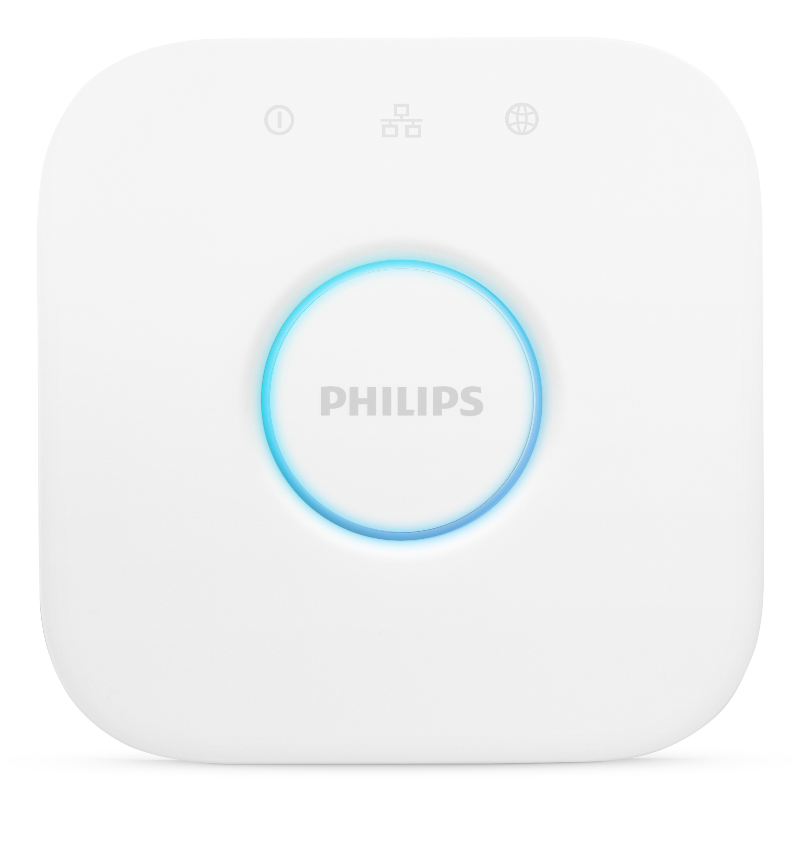

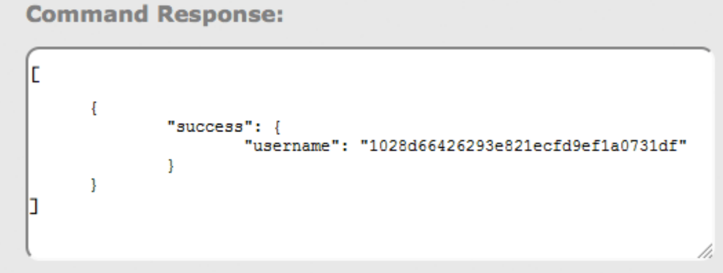
IMPLIMENTATION – redesigned:
2) OBTAIN API & USERNAME
b) RUN THE FOLLOWING COMMAND
c) CLICK THE BUTTON ON THE BRIDGE
d)Obtain the username
a) GO TO 👉:
https://<bridge ip address>/debug/clip.html

Slide 11
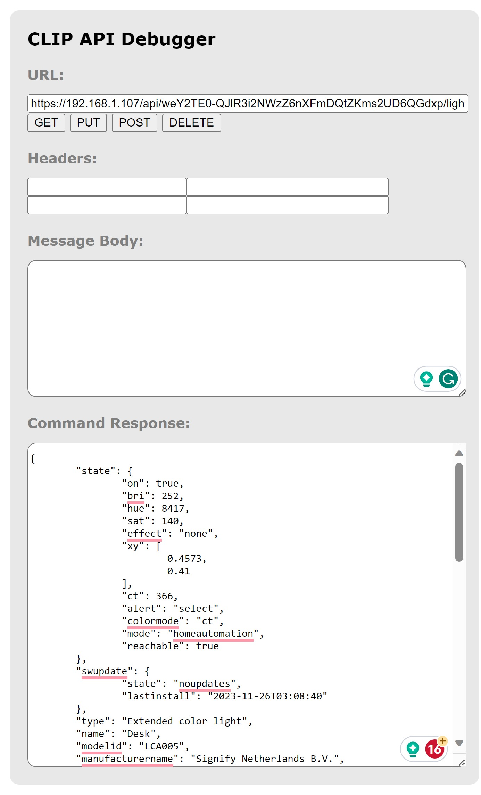
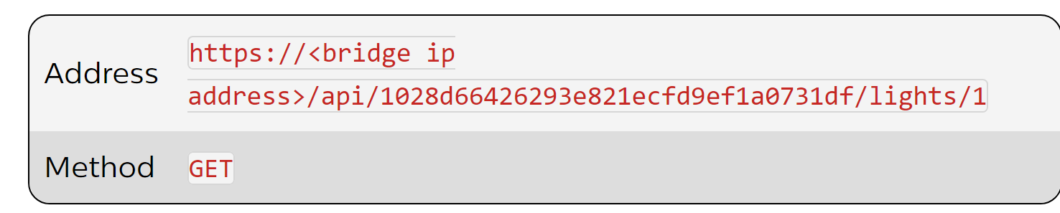
IMPLIMENTATION – OBTAIN THE LIGHT INFORMATION

Slide 12
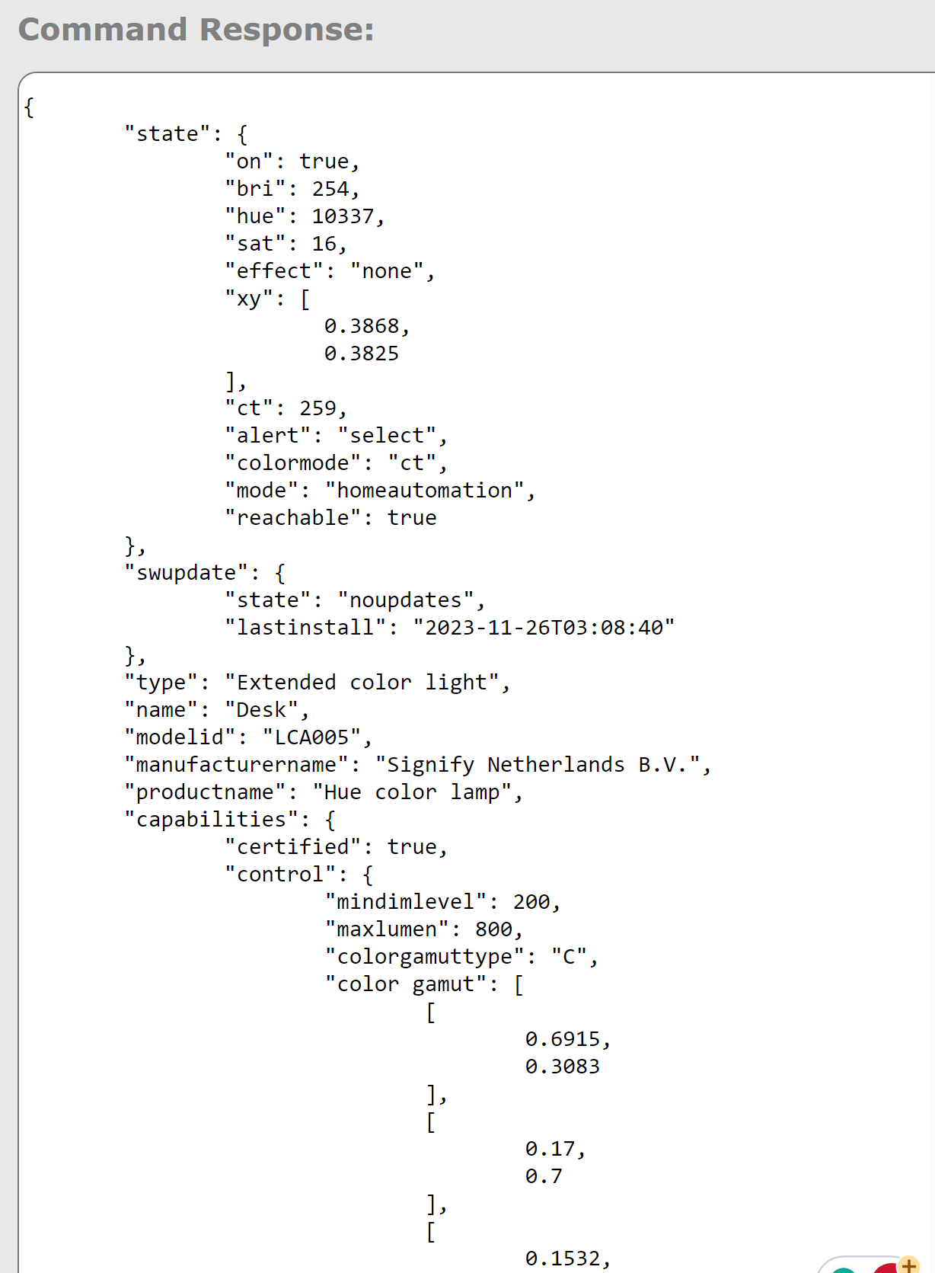
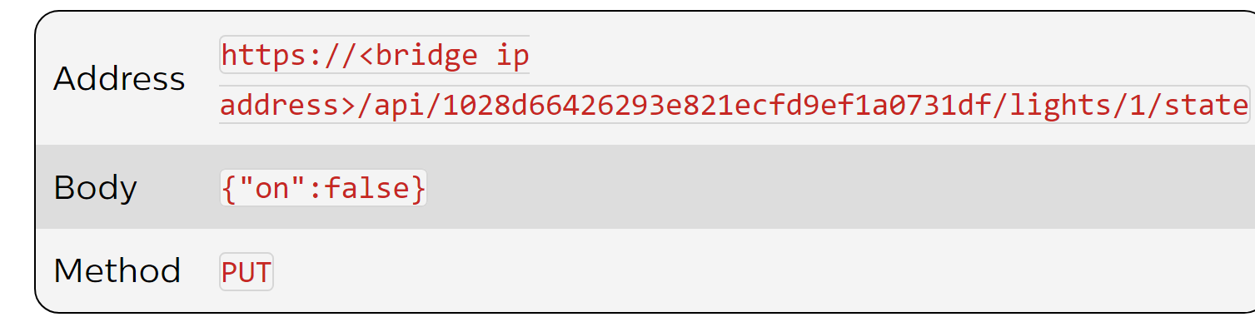
IMPLIMENTATION – interacting with Philips api interface
3) NOW WE CAN START CONTROLING THE LIGHT:
CHANGING THE ”on” PROPERTY FOR THE LIGHT WITH AN ID “1” ---> THIS WILL TURN OFF THE ACTUAL LIGHT
GET THE INFORMATION ABOUT THE LIGHT

Slide 13
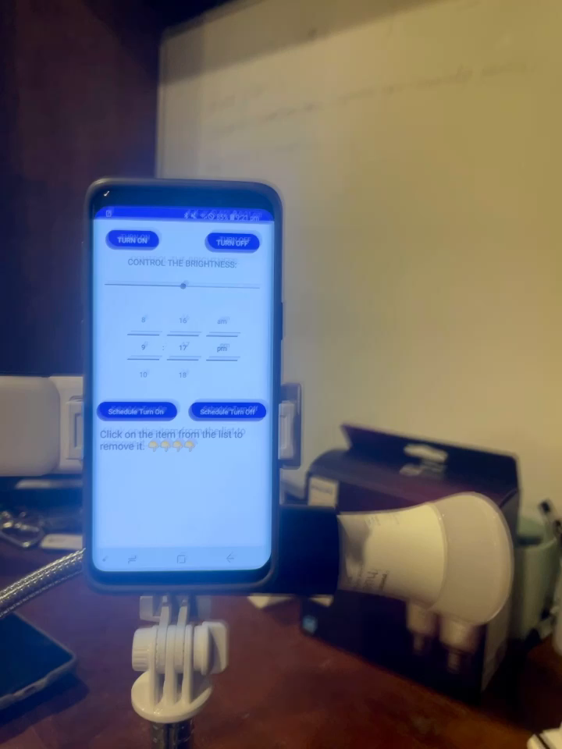
DEMO

Slide 14

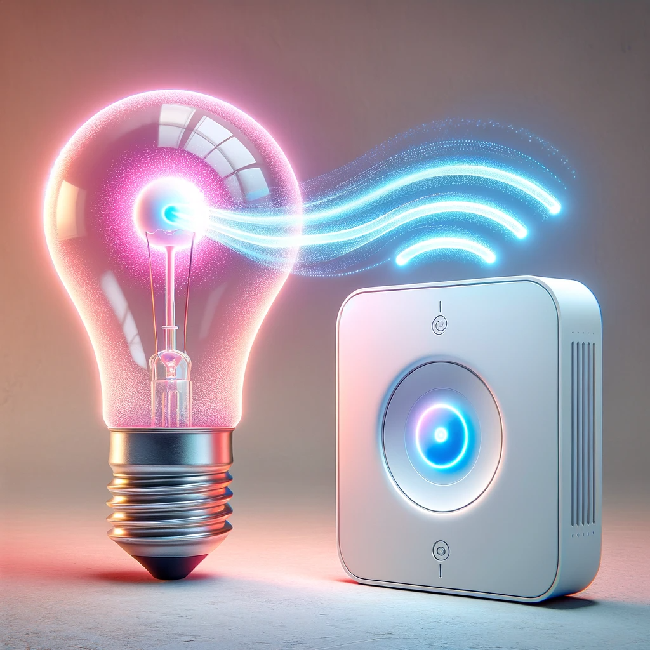
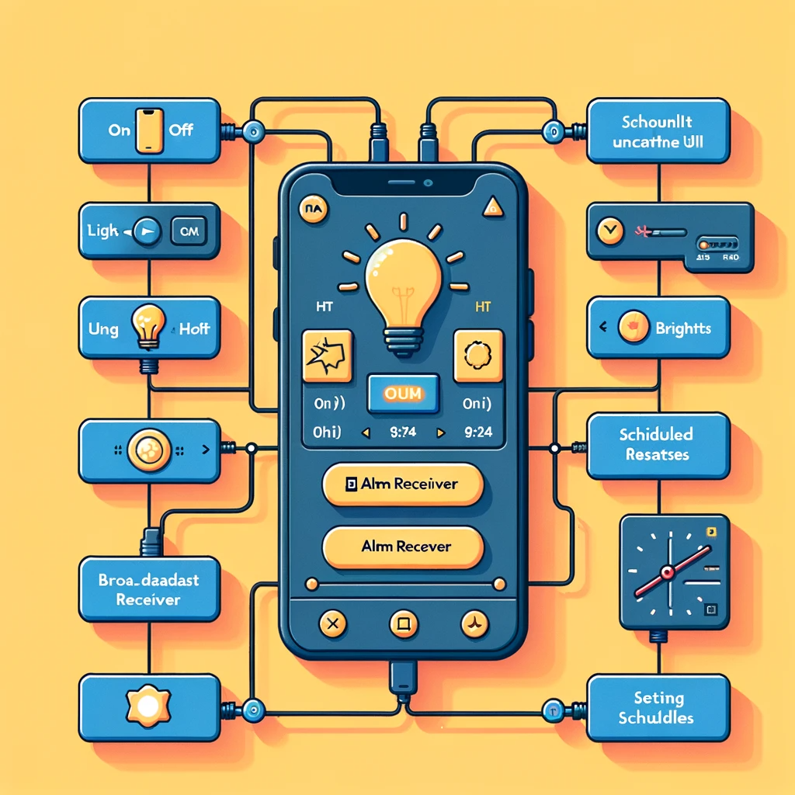
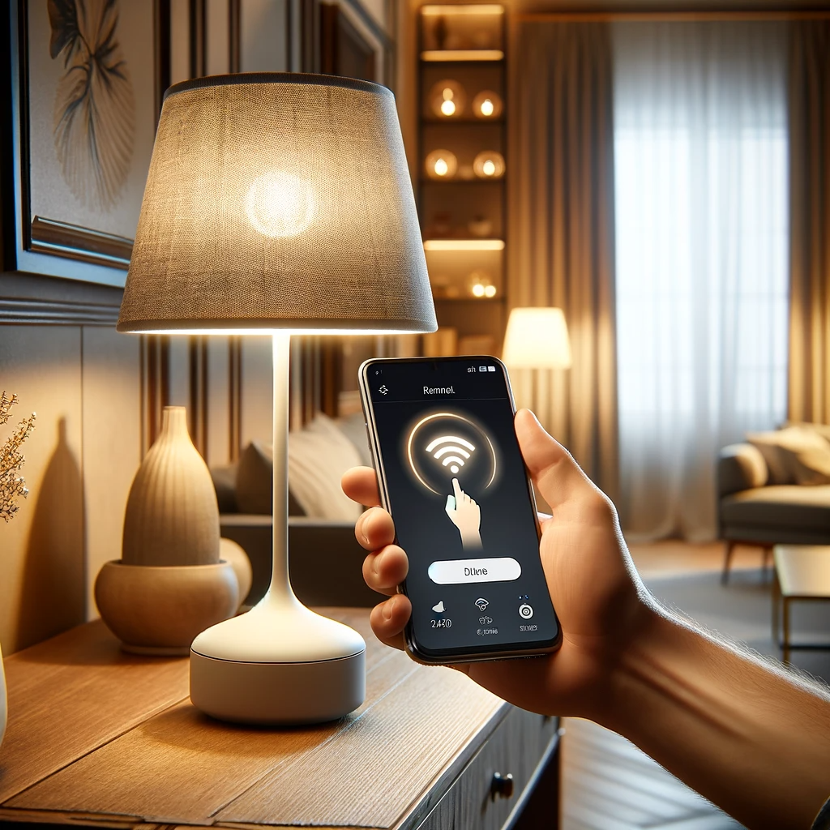
Thank you
Omar Madjitov

